Slide 1
INTRODUCTION TO UNCONVENTIONAL MACHINING PROCESS

Slide 2
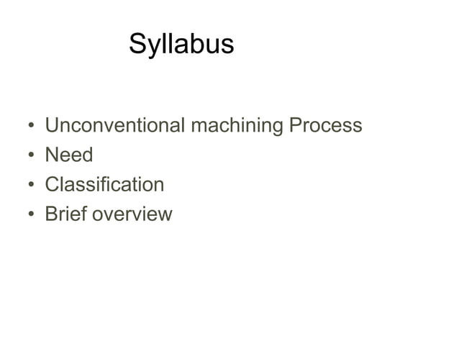

Slide 3
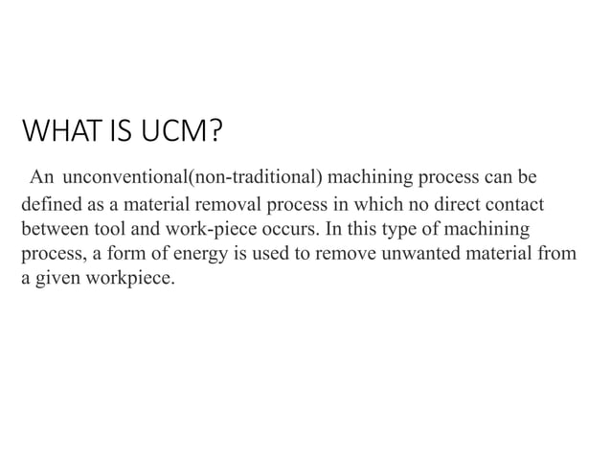

Slide 4
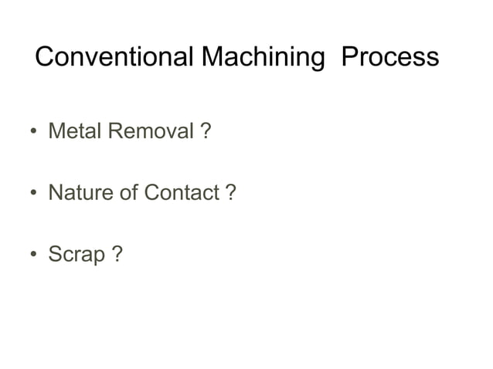

Slide 5
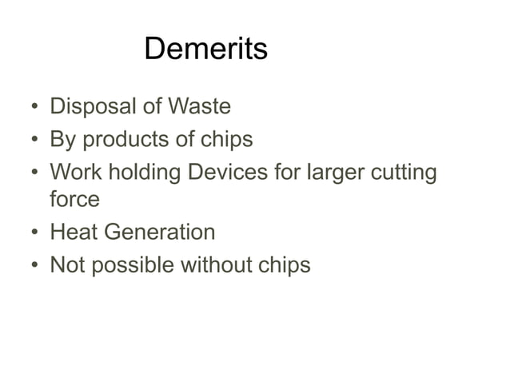

Slide 6
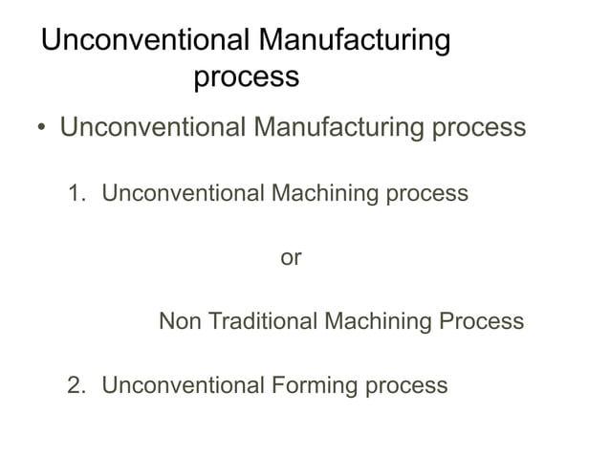

Slide 7
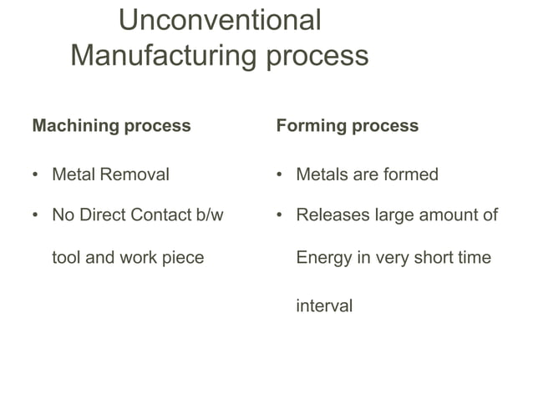

Slide 8
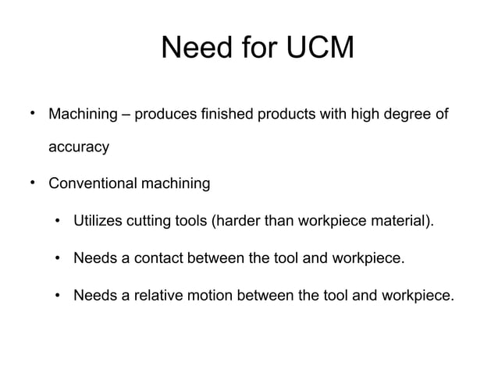

Slide 9
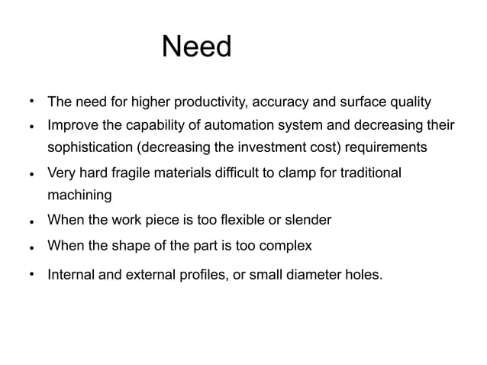

Slide 10
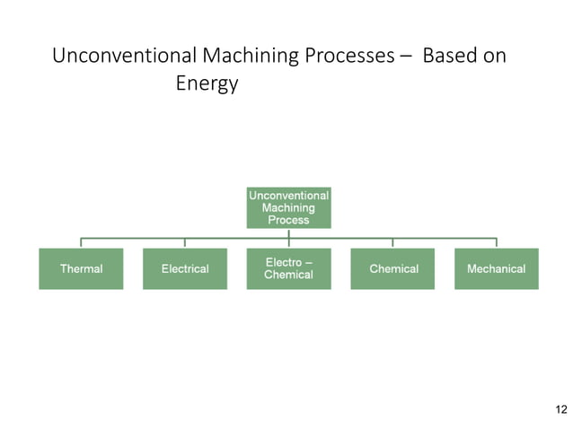

Slide 11
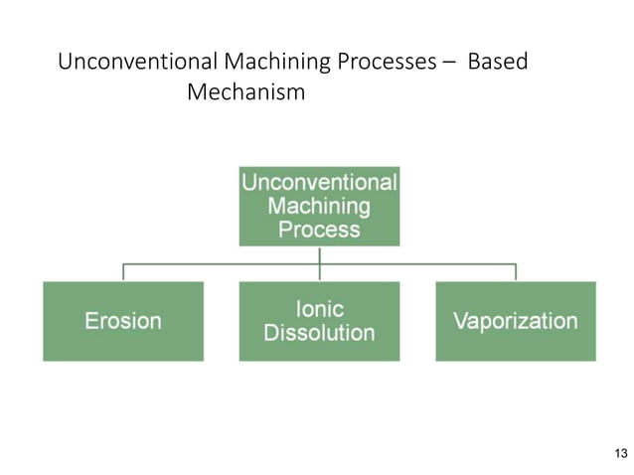

Slide 12
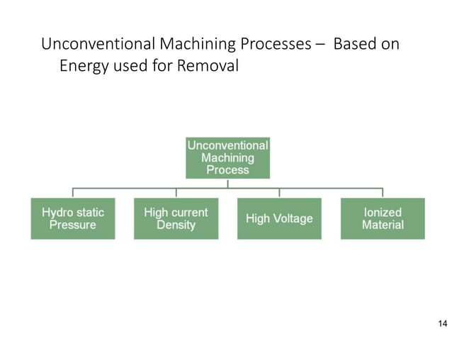

Slide 13
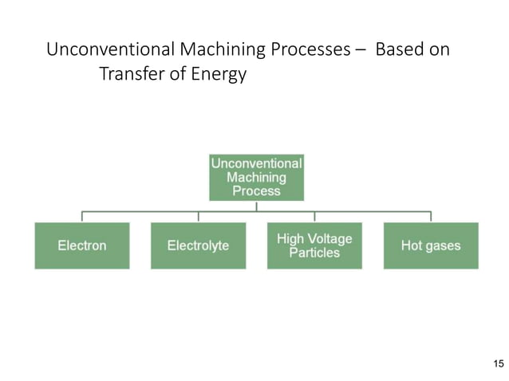

Slide 14
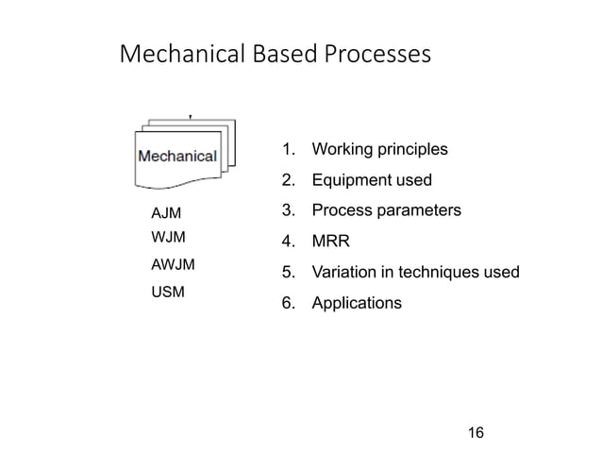

Slide 15
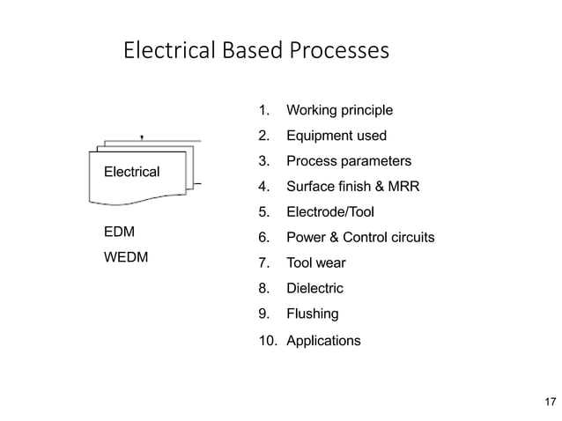

Slide 16
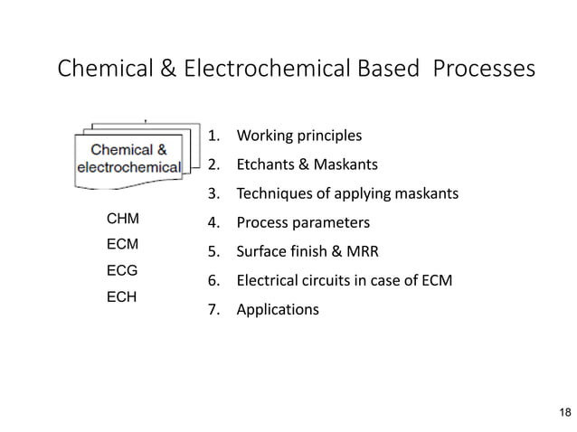

Slide 17
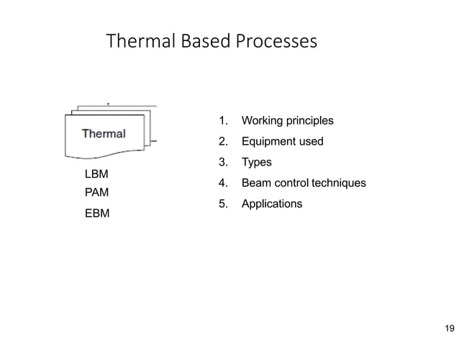

Slide 18
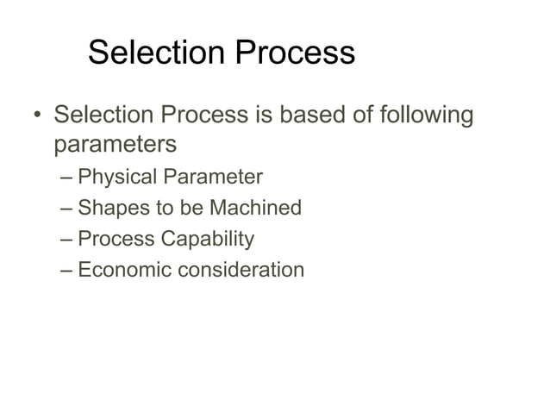

Slide 19
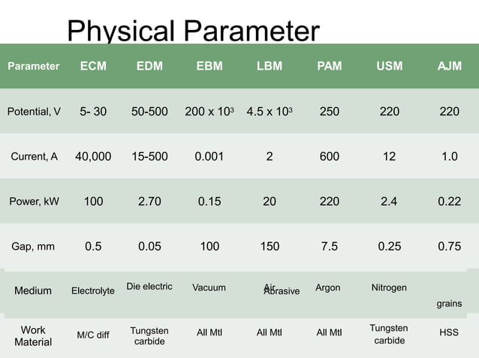

Slide 20
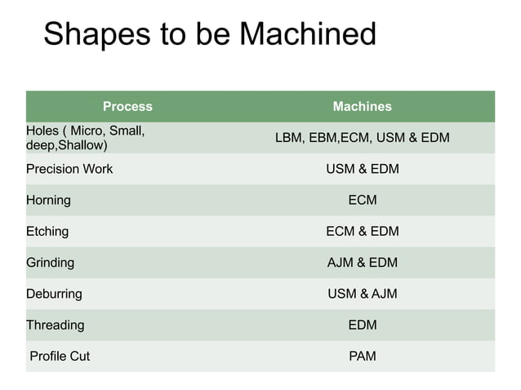

Slide 21
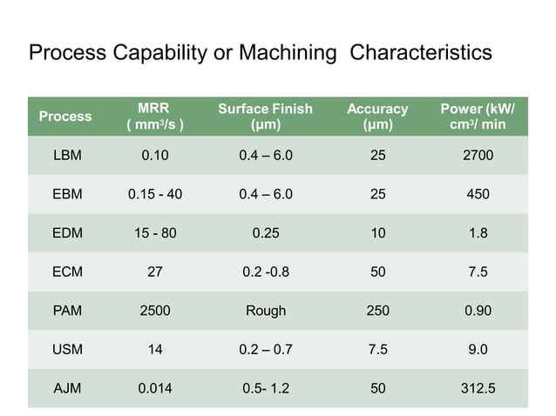

Slide 22
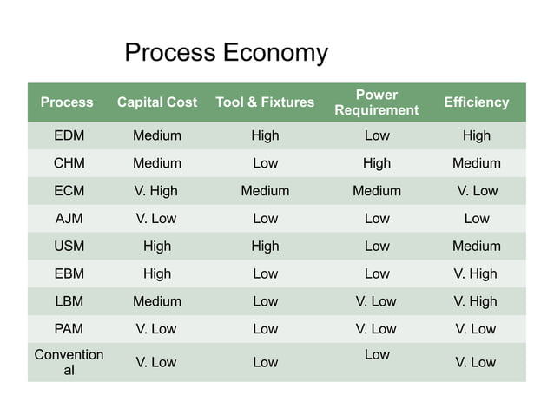

Slide 23
ADVANTAGES:
Material removed without mechanical contact with the workpiece
The material removal rate is independent of the workpiece
Cutting forces are independent of workpiece hardness
Tool material need not be harder than the workpiece material
Tool wear is not a problem
Ability to machine any material
Uniform material removal over the entire area
Intricate shapes and very hard and fragile materials can be machined.
Easy compatibility with numerical control and mini computer controls

Slide 24
DISADVANTAGES:
Work piece and tool must be electrically conductive
The depth of cut is limited(Ex:LBM)
Recast or Heat effected zones or surface produced may be troubled some times(Ex:EDM,LBM,EBM)
There may be taper in the side walls of holes or cavities
(Ex:EDM,LBM)

Slide 25
APPLICATIONS:
AJM- suitable for super alloys and refractory materials (ceramics and glass) and plastics
USM-suitable for refractory materials and plastics
ECM-suitable for steel, super alloys
Not used for nonconductive materials like ceramics, glass and plastics
EDM-suitable for steel, super alloys,titanium and refractory materials
Not used for nonconductive materials like ceramics, glass and plastics

Slide 26
EBM- suitable for refractory materials
medium performance on glass and plastics
LBM- suitable for refractory materials
medium performance on glass and plastics
PAM-suitable for alluminium,steel and super alloys
Not suitable for ceramics and glass

Slide 27
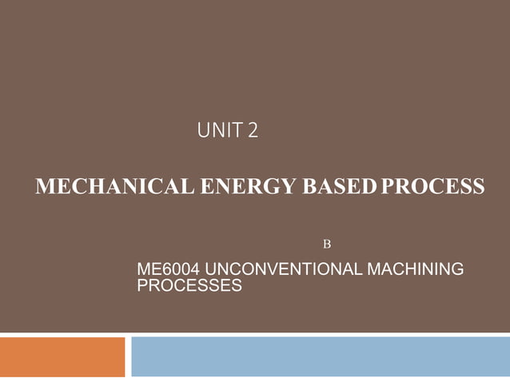

Slide 28
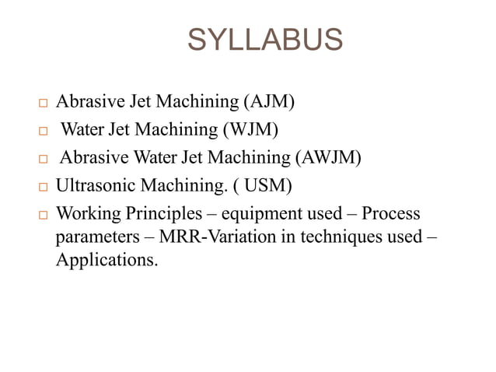

Slide 29
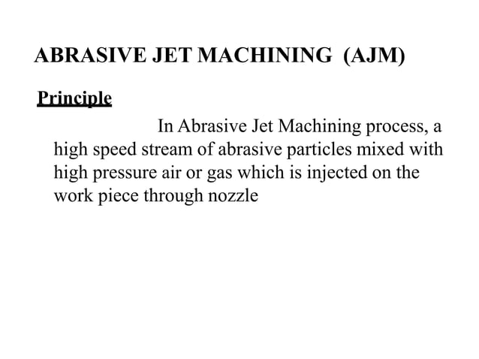

Slide 30
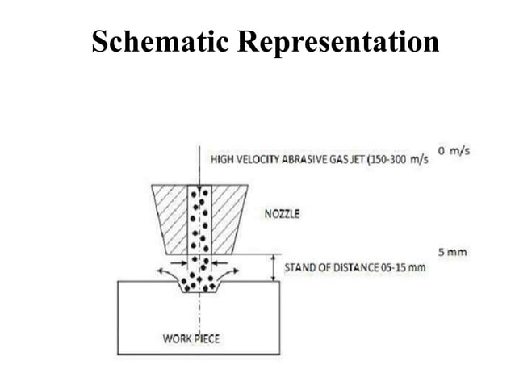

Slide 31
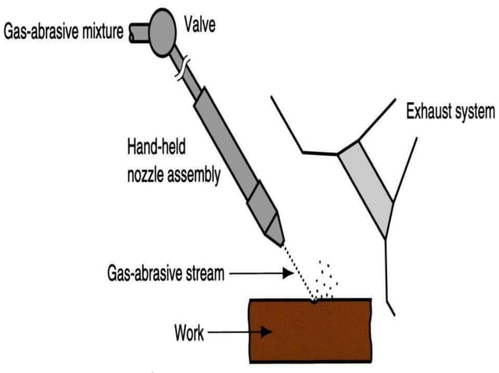

Slide 32
Operating Elements:
The operating elements are Abrasive, Carrier gas and the nozzle.
Abrasives:
Aluminium Oxide
Silicon Carbide
Sodiumbicarboante
Glass beads
Carrier gas:
Carbon dioxide, air, and nitrogen are used as carrier for the abrasive particles AJM.
The pressure is usually kept between 2 to 8 kg/cm2
Nozzle:
It is made of tungsten carbide or sapphire which has high resistance to wear.
It is made up of either circular or rectangular cross section.
The nozzle pressure is generally maintained between 2-8.5 kgf/cm2

Slide 33
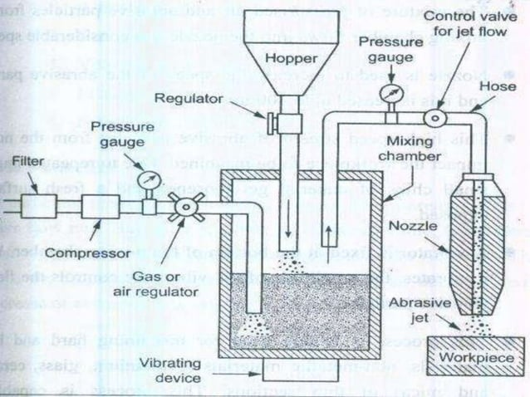
Equipment:
1.Gas Propulsion System
2.Abrasive Feeder
3.Machining Chamber
4.AJM Nozzle
5.Abrasives

Slide 34
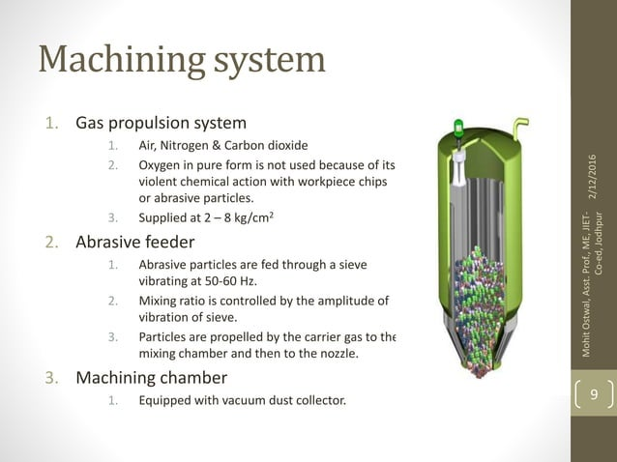

Slide 35
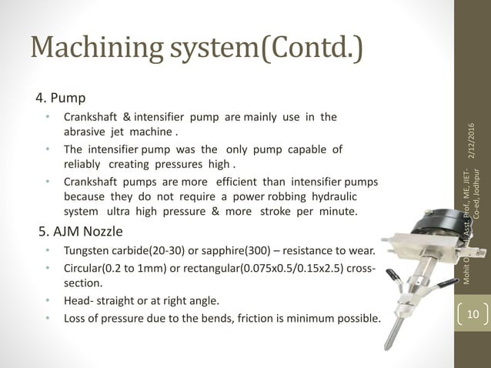

Slide 36
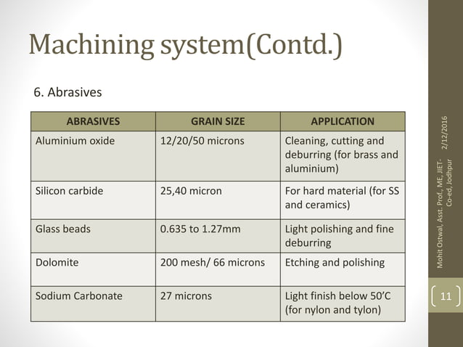

Slide 37
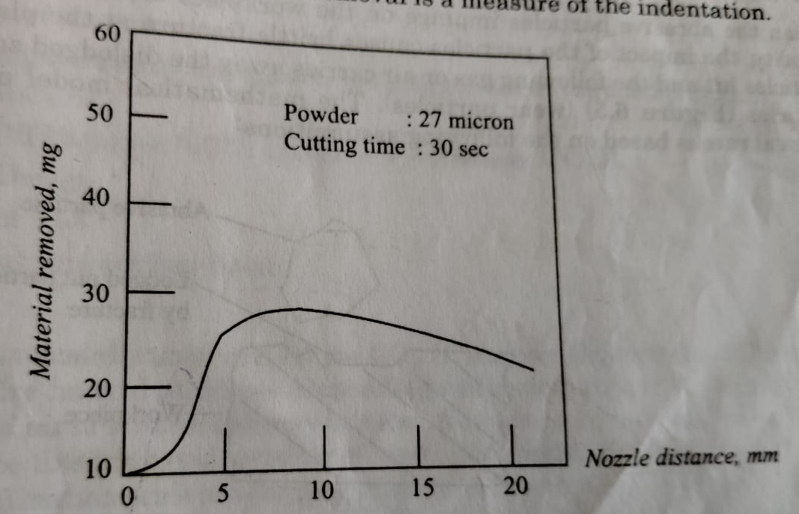
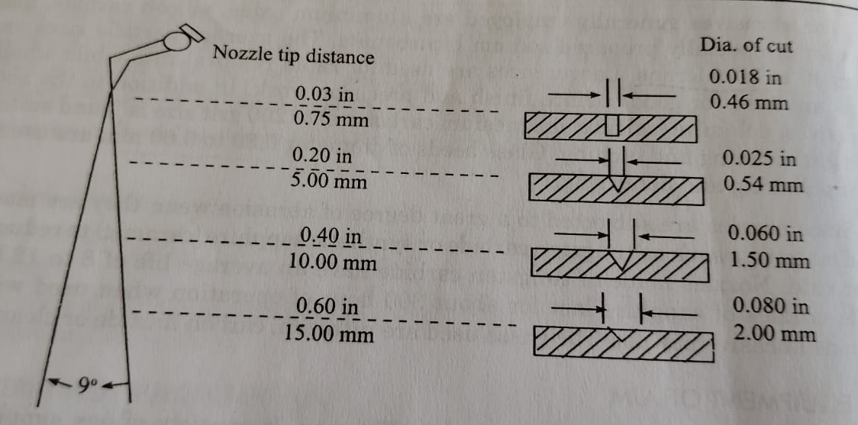
Material Removal Rate:

Slide 38
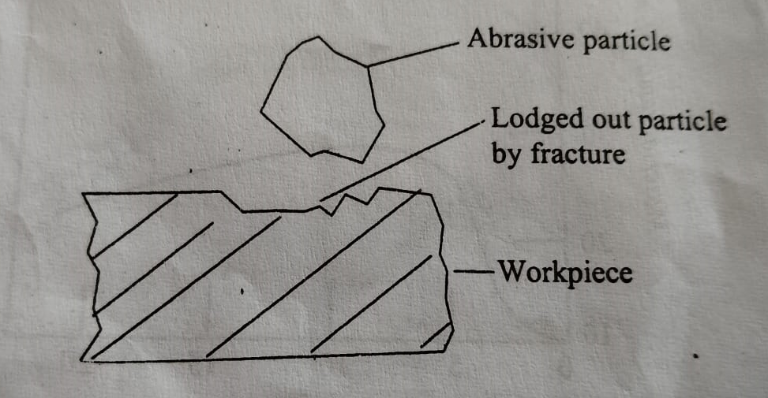
Mechanism of Metal Removal:

Slide 39
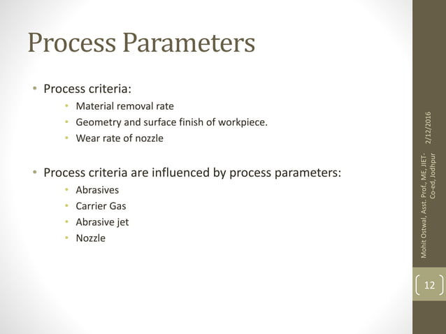

Slide 40
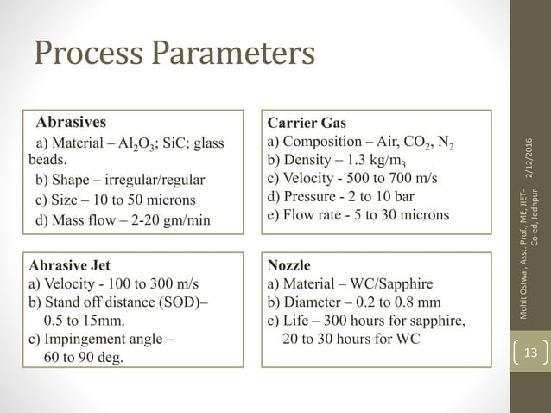

Slide 41
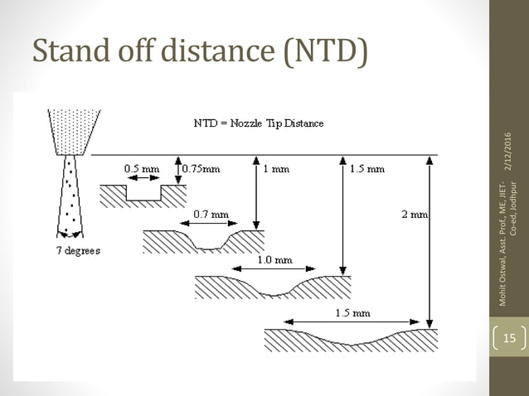

Slide 42
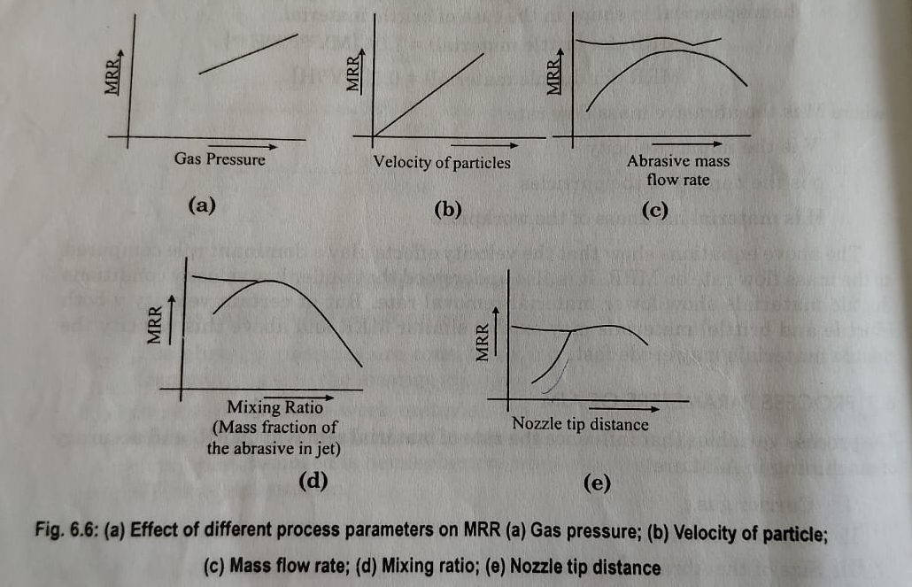
Effect of Process Parameters on MRR:

Slide 43
Advantages:
Low capital cost
Less Vibration
No heat is generated
The work remains clean and dustfree.
Ability to cut fragile, brittle, hard and heat-sensitive materilas without damage.
Ability to cut intricate hole shapes of any hardness and brittleness in the material.
Disadvantages:
Low metal removal rate.
Particles can be imbed into workpiece.
Abrasive powder can not be reused.
Due to stray cutting accuracy can be affected

Slide 44
Applications:
For cleaning hard surfaces,safe removal of sticky substances on ceramics, oxides on metals.
Machining semiconductors such as germanium,gallium etc.
For drilling holes of different shapes and cutting fine lines on surfaces and thin sections.
Used for deburring,scribing,grooving,polishing.

Slide 45
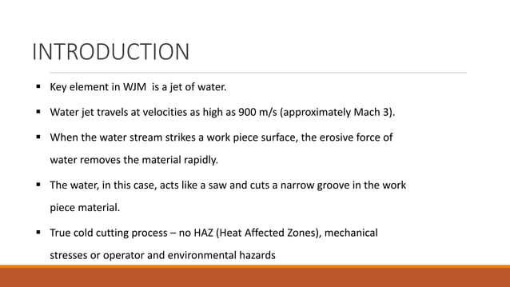

Slide 46
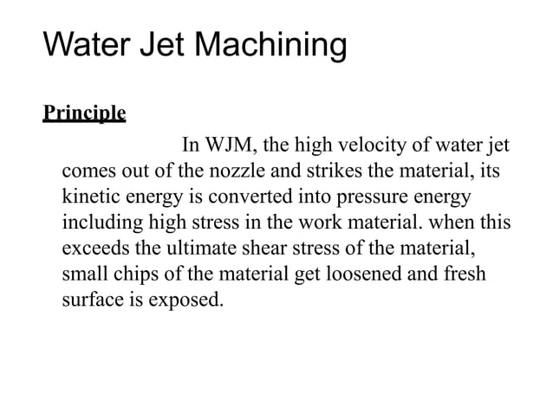

Slide 47
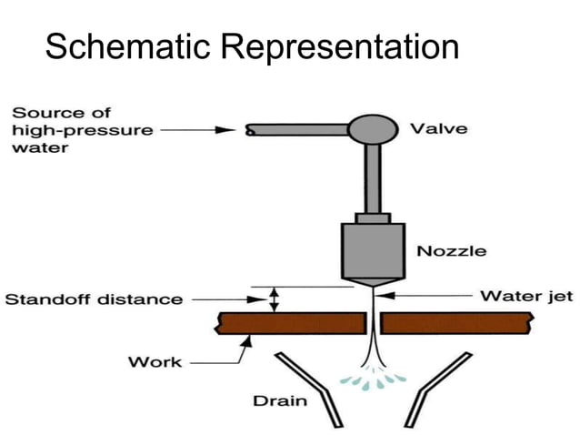

Slide 48
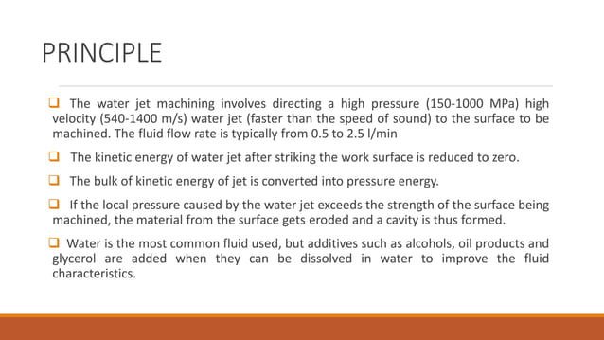

Slide 49
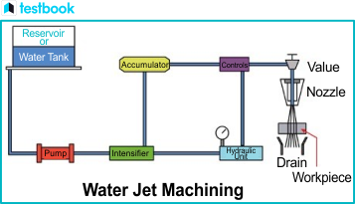

Slide 50
Equipment:
Hydraulic Pump
Intensifier
Accumulator
High pressure tuble
Jet nozzle.

Slide 51
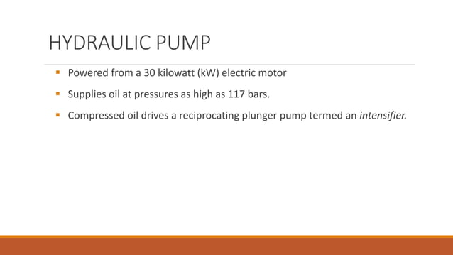

Slide 52
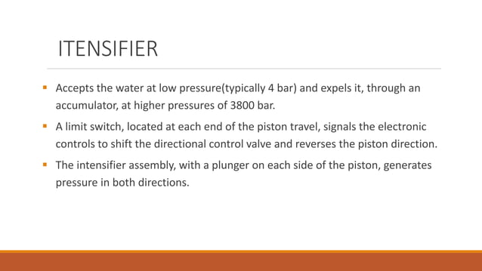

Slide 53
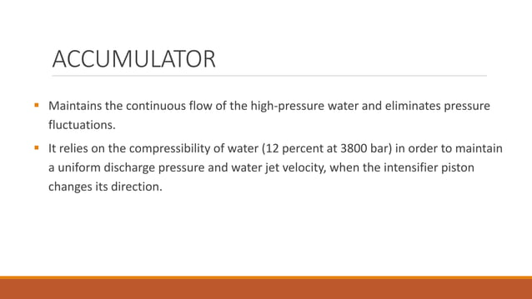

Slide 54
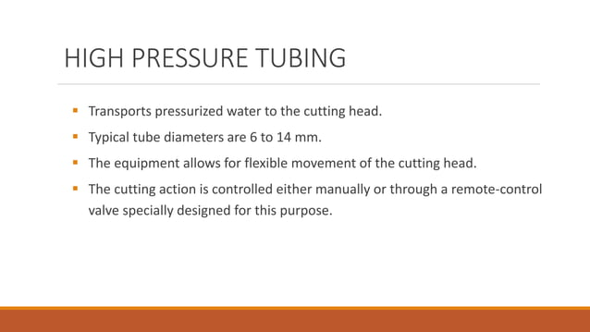

Slide 55
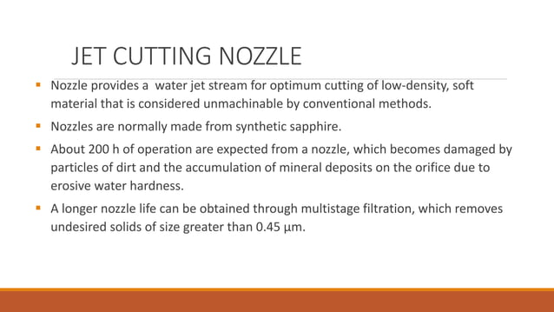

Slide 56
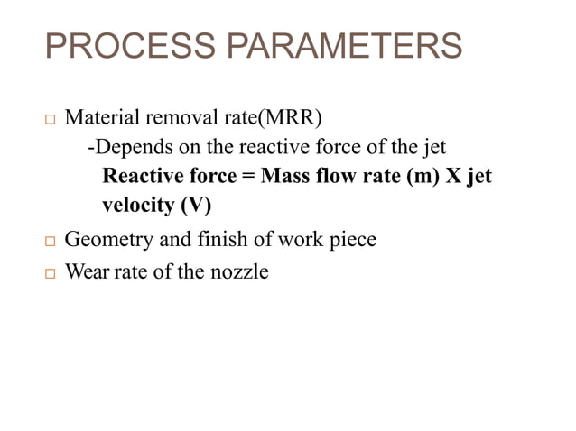

Slide 57
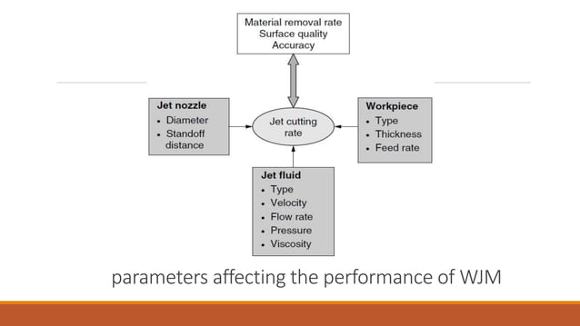

Slide 58
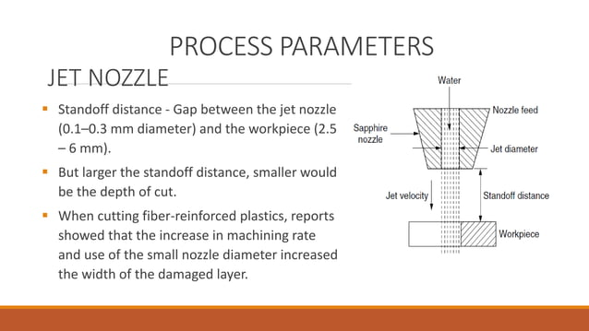

Slide 59
Advantages:
Ability to cut intricate hole shapes in materials of any hardness and brittleness.
Ability to cut fragile and heat sensitive materials without damage as no heat is generated due to the passing of gas or air.
Low capital cost.
Disadvantages:
Low metal removal rate.
Machine accuracy is poor.
Nozzle wear rate is high.
Additional cleaning of the work surface may occur as there is a possibility of sticking abrasive grains in softer materials.

Slide 60
Applications:
It is used to cut many non-metallic materials like graphite ,boron,leather and many other brittle materials.
It is used in shoe making industry.
It is used in aircraft industries to profile cutting of FRP aircraft structures even glass windows.

Slide 61


Slide 62


Slide 63


Slide 64
Equipment:
The abrasive water jet machining setup is made up of four important elements
1. Pumping system
2. Abrasive feed system
3. Abrasive water jet nozzle
4. Catcher

Slide 65

Schematic diagram of AWJM:

Slide 66
Process Variables:
Parameters which affect performance of AWJM process are
1.Water(flow rate and pressure)
2.Abrasives(type,size,and flow rate)
3.Water Nozzle and abrasive jet nozzle(design)
4.Cutting parameters(feed rate and stand off distance)
5.Work material

Slide 67
Advantages:
It is used to cut electrically non-conductive as well as difficult to machine materials.
Dust free
High cutting speed
It has multidirecrional cutting capacity
No fir hazards
Recycling of abrasive particles
Low power requirement
Disadvantages:
Low metal removal rate.
Machine accuracy is poor.
Nozzle wear rate is high.
Additional cleaning of the work surface may occur as there is a possibility of sticking abrasive grains in softer materials.

Slide 68
Aspplications:
It is employed to cut a wide range of materials including both metals(copper, aluminum, lead, etc) and nonmetals (glass, concrete, graphite, etc).
Slotting is one of the common application
The edges of the structural aluminum plate have also been successfully cut.
This technique is used in several industries like aerospace, nuclear, construction, and glass.

Slide 69


Slide 70


Slide 71


Slide 72


Slide 73


Slide 74
Components:
Ultrasonic Oscillator
Transducer
A connecting body
A horn
Feed device
Pump
A container for the slurry of abrasive grains
Workpiece holding device

Slide 75
Operating Elements:
Ultrasonic Transducer
Concentrator
Tool
Abrasive Slurry
Abrasive feed mechanism
Tool feed mechanism

Slide 76
Ultrasonic Oscillator:
This oscillator is employed to generate high frequency oscillating current.
The method to be selected depends upon the frequency range to be covered and the power output.

Slide 77
Transducer:
Transducer is a device which converts energy from one form to another i.e., it can generate or receive sound waves
Acoustic Transducer:
An acoustic transducer converts electrical ,mechanical or thermal energy to acoustical energy
Types of Transducers
Purely Mechanical Transducer-Whistles and Siren
Electromagnetic Transducer-microphones and loud speakers
Electrostatic Transducer-internal friction measurement, condenser microphones

Slide 78
Crystal Transducer-
Crystal means materials which exhibit piezoelectric effect.
These materials divided in to
-Natural crystals (such as quartz,rochella salt etc)
-Synthetic crystals (such as lithium,ammonium etc)
-polarized ferroelectric ceramics (such as barium, titanate)
Such materials are used to generate vibration in the tool.

Slide 79

Ultrasonic Transducer

Slide 80
The device used for converting any type of energy in to ultrasonic waves or vibrations is called Ultrasonic Transducer.
Ultrasonic vibrations are induced by two types of effects.
Piezoelectric crystals effect
Magnetostrictive effect
Piezoelectric crystals: These are used for inducing ultrasonic vibrations since they posses the capability of converting electrical energy into mechanical vibrations.
These are more efficient i.e., they involves less loss of power and do not require cooling.

Slide 81
Magnetostrictive effects:These are also used for inducing ultrasonic vibrations.(The material changes its dimensions in response to magnetic field).
The tranducer may be piezoelectric or magnetostrictive type depending upon the choice of the operation to be performed on a specific work piece.
Concentrators:
It provides the link between the tool and the transducer.It is also called as toolcone,horn,tool holder.
The purpose of this is to increase the amplitude of vibration obtained from the transducer.

Slide 82

Types of Concentraors:

Slide 83

Function:
It is made up of stainless steel or titanium alloy.
It is fitted by brazing to the transducer.
Titanium material has the best
acoustical properties but machining
to a particular horn shape and brazing is
difficult.
The amplitude of vibration increased
by the concentrator based on the
principle of resonance.

Slide 84
Tool:
It is fixed at the end of concentrator by brazing or soldering.
The tool tip is made up of diamond,stainless steel ,brass or copper.
If the ratio of the w/p hardness and tool hardness increases
the material removal rate decreases.
The area of the tool should not be more than the area of the concentrator.
Abrasive Slurry:
It is a mixture of abrasive grain and the carrier fluid generally water.
Abrasive used are Aluminium oxide, Boron Carbide, Silicon carbide,Diamond dust etc.
Boron carbide is the best,more efficient and fastest cutting abrasive.
It is expensive and used for cutting harder materials like tungsten carbide,precious stones.
Silicon carbide is used on glass, germanium and some ceramics.
The cutting time with Siliconcarbide is about 20-40% more than the Boron Carbide.

Slide 85
Abrasive Feed Mechanism:
The abrasive feed mechanism is supplied through a nozzle by a pump
A good method is to keep the tool and w/p in a bath of slurry.
This ensures good supply of slurry and reduces any tendency of the tool to scatter the slurry the amplitude is large.
Another efficient method is to supply the slurry to the cutting zone through a hollow tool.
Tool Feed Mechanism:
The objective is to apply the static load between the tool and the w/p during machining operation.
It also brings the tool slowly close to the w/p surface and provide adequate constant cutting force.
Feed may be given to acoustic head or to the w/p, but in general it is given to the acoustic head so as to facilitate positioning of the w/p in x-y direction.
It controls the penetration rate and depth of machining.

Slide 86
Types of Tool feed Mechanism
Spring type-Quite sensitve
Counter weight type
- In this the force of impact is the difference between the weight of the acoustic head and the counter weight attached
- This type is insensitive and inconvenient for adjusting during the operation.
Motor type – used for high rating machine
Pneumatic and hydraulic type- used for high rating machine

Slide 87


Slide 88


Slide 89


Slide 90


Slide 91
Disadvantages:
Low material removal rate
Not suitable for soft materials.
Not suitable for heavy stock removal.
Abrasives may get embedded in the workpiece, especially while machining soft materials like soft plastics.
Applications:
Diamond, Tungstencarbide,gemstones can be machined.
It is used for drilling, grinding, coining, threading and even for welding.
Circular and noncircular, blind holes and through holes can be easily produced.
Used in jewellery for shaping precious stones.
Drilling of screw threads nad curved holes in brittle materials.
Machining shallow cavities of irregular and complex shapes.

Slide 92


Slide 93


Slide 94


Slide 95


Slide 96


Slide 97


Slide 98


Slide 99


Slide 100


Slide 101


Slide 102


Slide 103


Slide 104


Slide 105


Slide 106


Slide 107


Slide 108


Slide 109


Slide 110


Slide 111


Slide 112


Slide 113


Slide 114


Slide 115


Slide 116


Slide 117


Slide 118


Slide 119


Slide 120


Slide 121


Slide 122


Slide 123


Slide 124


Slide 125
CHEMICAL MACHINING:
In ancient days this process is used by artists for engraving the metals.
It is a process used to remove material by dissolution in a controlled manner, from the workpiece by the application of acidic or alkaline solution(etchant).
Maskants are used to cover the workpiece surfaces which are not to be machined.
This technique is used quite useful for producing complex configurations in delicate parts.
This is used in many industries like printed circuit boards, jewelery, for making aircraft wing panels etc.

Slide 126

Chemical machining are of two types
1.Chemical Milling – shallow cavities on sheets,plates or to reduce the weight.
2. Chemical Blanking – it is usually penetrate the material entirely (holes,slots etc) are produced.
Schematic diagram of Chemical Milling

Slide 127
Performance of machining is influenced by many process parameters, i.e., type of etchant, temperature of etchant, type of maskant, method of applying the maskant, method of circulating the etchant.
The suface finish produced during this process is about 0.75-3.75μm
Maskants:
These are used as protecting surfaces from chemical etching by etchants.They are basically 3 types
1.Cut and Peel
2.Screen print
3.Photoresist

Slide 128
1.Cut and Peel:
Neoprene,butyl or vinyl based materials.
The thickness of the coating usually ranges from 0.025-0.13mm.
Applications are large sized workpieces used in chemical industries, aircraft industried,missile industries etc.
This technique is good for batch production, for products with large depth(>1.5mm) to be etched etc.
2.Screen Printing:
It is good for high volume production with low accuracy.low itching depth(<1.5)
For parts sized normally not more than 1.2m*1.2m
3.Photoresist Maskant:
Called as photo chemical machining
Produce complicated but accurate shapes.

Slide 129


Slide 130


Slide 131


Slide 132
Applications
Large turbine engine containment rings.
Milling of spun alluminium pressue vessels bulkheads
Shuttle components

Slide 133


Slide 134


Slide 135


Slide 136


Slide 137


Slide 138


Slide 139


Slide 140


Slide 141


Slide 142


Slide 143


Slide 144


Slide 145


Slide 146


Slide 147


Slide 148


Slide 149


Slide 150


Slide 151


Slide 152


Slide 153


Slide 154


Slide 155


Slide 156


Slide 157


Slide 158


Slide 159


Slide 160


Slide 161


Slide 162


Slide 163


Slide 164


Slide 165


Slide 166


Slide 167


Slide 168


Slide 169


Slide 170


Slide 171


Slide 172


Slide 173


Slide 174


Slide 175


Slide 176


Slide 177


Slide 178


Slide 179


Slide 180


Slide 181


Slide 182


